Slide 1



TRACK & TRACE:
ANIMAL SPECIES CLASSIFICATION BASED ON FOOTPRINTS AND SOUNDS
P.S.V. Anirudh,
BCA Student,
GVP college.

Slide 2
Contents
Abstract
Introduction
Existing system
Problem statement
Proposed System
Flow Diagram
Algorithm
Advantages
Disadvantages
Requirements
Example
Key features
Conclusion
TRACK & TRACE

Slide 3
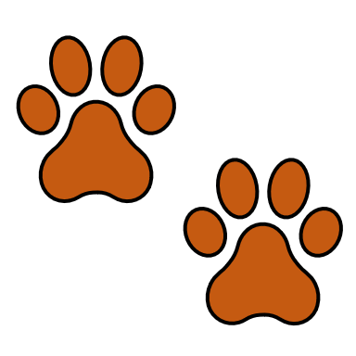
Abstract
1
Traditional Animal classification is somehow complex and inefficient process, so to reduce the complexity we are using Track & Trace, that classifies animal species using footprint images and audio recordings of animals. Firstly, the Footprint images are converted into gray-scale and applies the data augmentation. For audio classification, animal sounds are converted into Mel spectrograms. This project lies on the Deep Learning techniques i.e., CNN (Convolutional Nueral Networks) for predicting the animal classes and classifies it into the safe or unsafe category.
TRACK & TRACE

Slide 4
Introduction
2
A smart system that can automatically recognize animals based on their footprints or sounds using Deep learning techniques.
The approach utilized unique animal characteristics, benefiting outdoor activities such as camping and hiking/trekking. It also helps farmers to protect livestock from predator attacks by identifying potential threats.
This classifier can be integrated into mobile applications or surveillance systems for real-time monitoring. It will help researchers and forest department to identify animals quickly and accurately, supporting wildlife observation and conservation efforts.
TRACK & TRACE

Slide 5
Existing System
3
There are several techniques are currently existed to study the behavior of animals.
Manually Analyzing the footprints and sounds by biologists and forest department.
Some systems use simple pattern-matching for animal classification, but they lack Deep learning capabilities.
TRACK & TRACE

Slide 6
Problem Statement
4
For the people who goes for trekking/camping in the forests may faces the animal attacks or wild threats. By tracking them initially would alert and keep safe from the animals.
There is no such common tool that integrates the both footprints and sounds together.
Existing systems usually handle either footprints or sounds, but not both in a unified platform.
There is the lack of category wise classification with more user-friendly interface.
TRACK & TRACE

Slide 7
Proposed System
5
The image processing techniques have been established to optimize the footprints, input image is converted into greyscale, follows the edge detection and involves the augmentation methods.
Same as the audio processing techniques the input audio is converted into mel-spectrogram, follows the noise reduction, and involves normalization.
It uses a simple desktop application that offers a user-friendly interface and can works without the internet.
It can be deployed in a mobile application by using a Flask app.
TRACK & TRACE

Slide 8
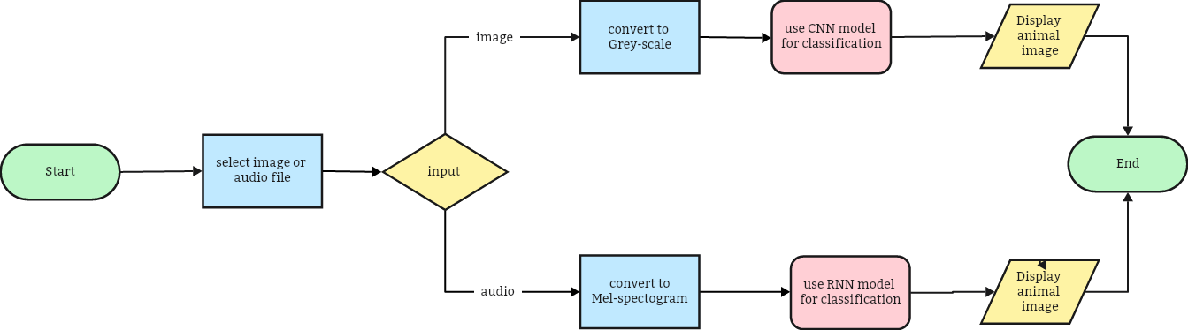
Flow Diagram
6
TRACK & TRACE

Slide 9
Algorithm
7
Step - 1: Collect the datasets (footprints/sounds) and apply the data preprocessing techniques to get the clean data by eliminating the unwanted stuff.
Step - 2: Now load the processed data into the model for training and feature extraction.
Step – 3: Save the best model for making predictions and further use.
Step – 4: Import the best pre-trained models into the Flask/GUI application to classify the output animal.
Step – 5: Display the predicted animal species name with additional information/images about the species.
TRACK & TRACE

Slide 10
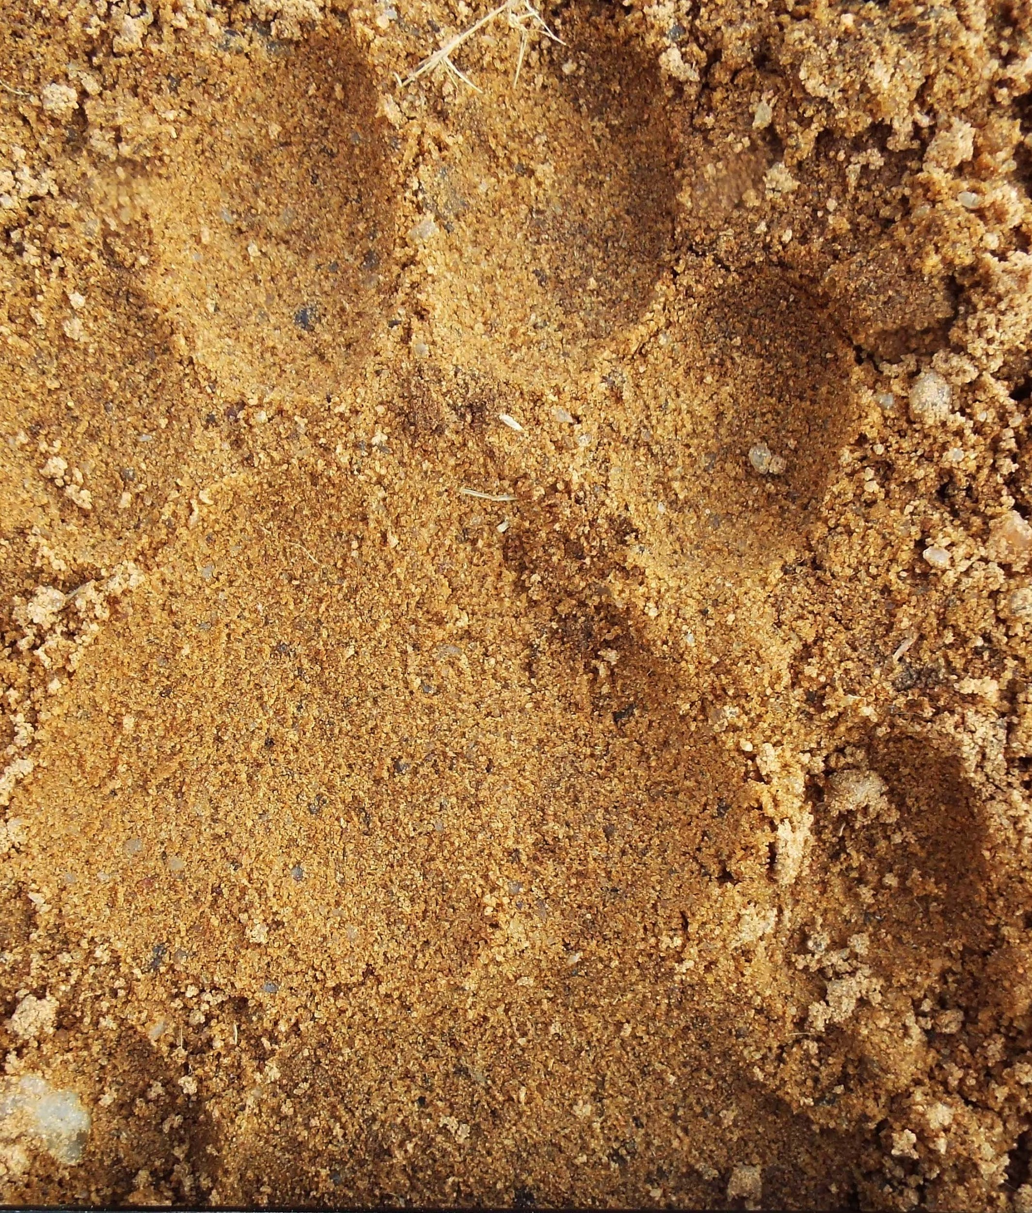
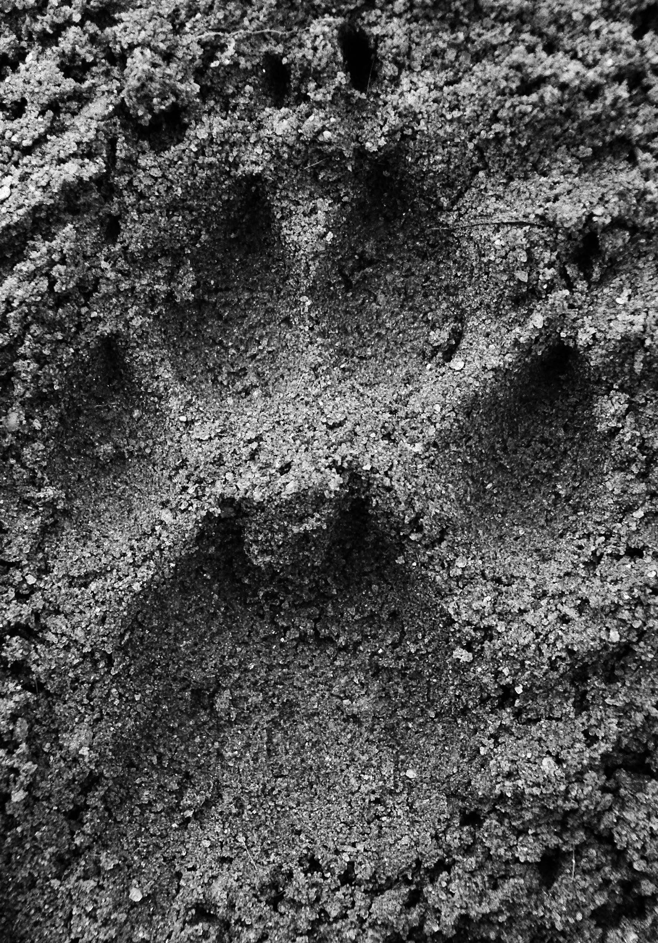
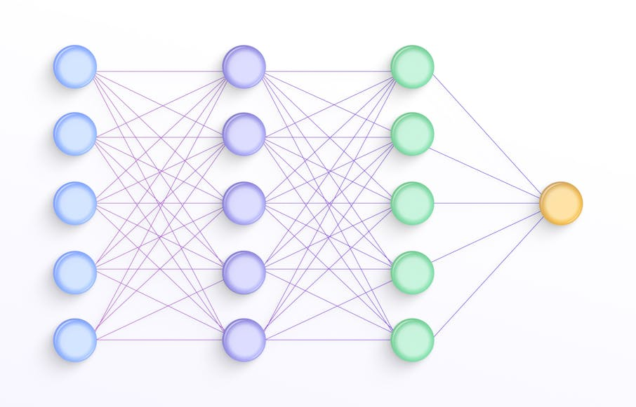
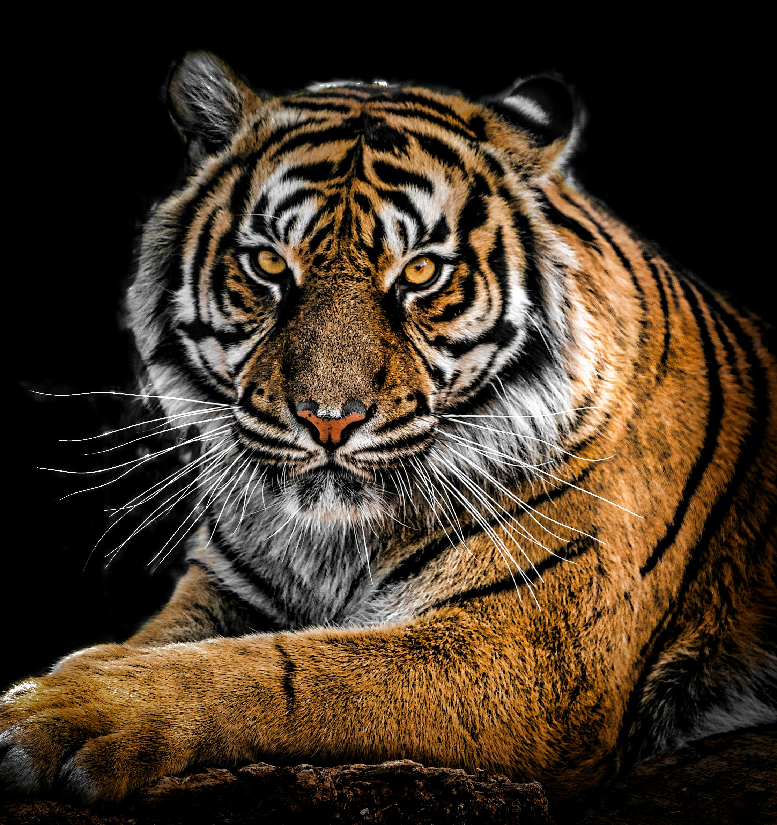
8
Example
Input Image
Grey-scale Image
CNN
Output Image
Animal footprint classification
TRACK & TRACE

Slide 11
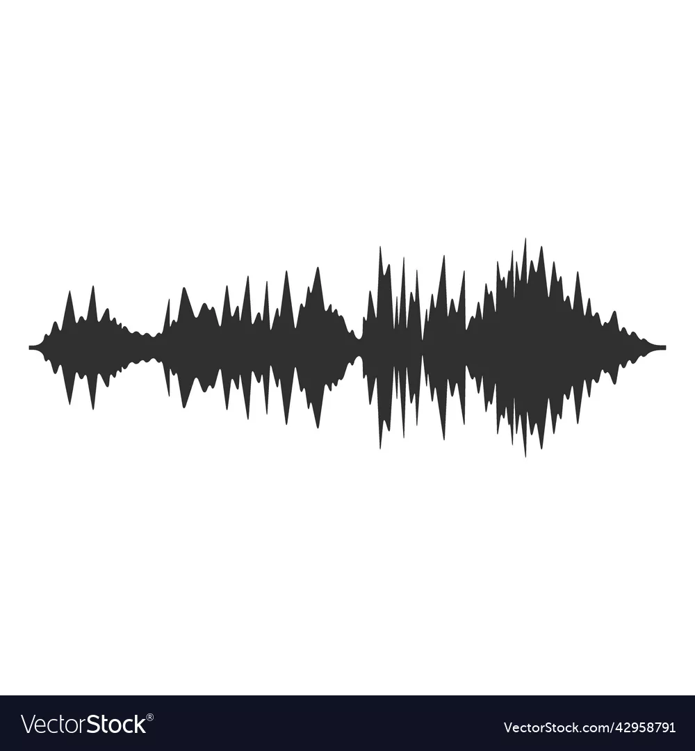
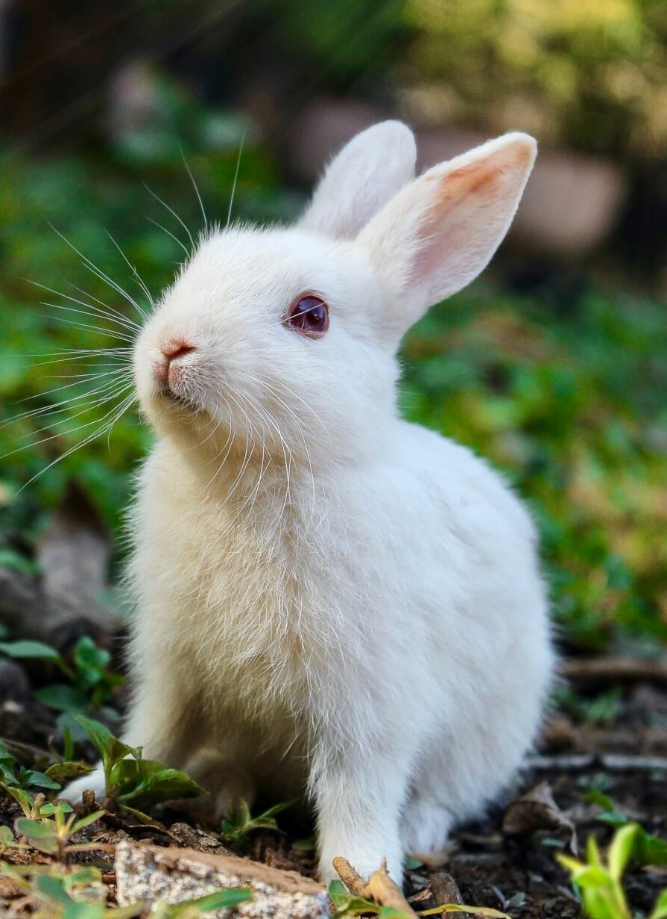
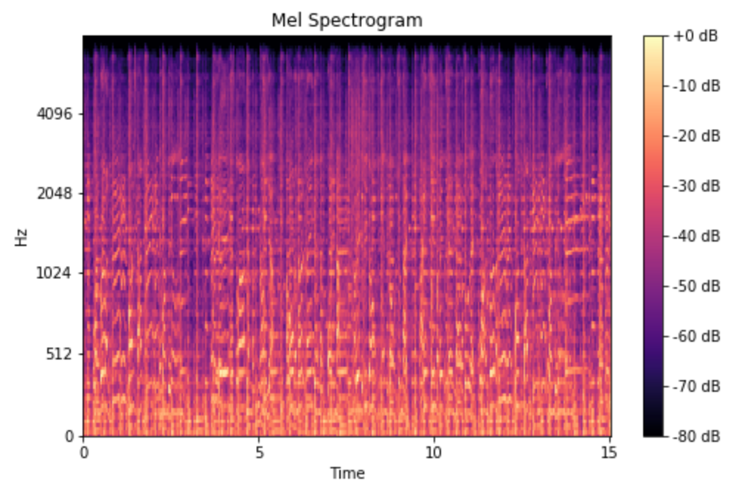
Example
9
Spectogram
CNN
Output Image
Audio Wave
Animal sound classification
TRACK & TRACE

Slide 12
Advantages
10
It supports the 2 different input types in any formats like images in [png, jpg, jpeg] and audios in [wav, mp3].
It displays the respective animal image as the output with additional information.
It also represents the output by indicating with the colors to make more user friendly.
The model is built on the advanced Deep learning techniques and can be run in any device. It is also Internet independent.
TRACK & TRACE

Slide 13
11
Disadvantages
This model may predict the animal classes inaccurately sometimes. Because both the models achieved less than 90% accuracy.
The model is trained on the small dataset with limited animal species/classes.
There is no live capturing feature, the user have to select and upload the files manually.
TRACK & TRACE

Slide 14
Requirements
12
Hardware Requirements :
Processor: i5 and Above
RAM: Greater than 16 GB
Hard Disk: 500 GB
Software Requirements:
Operating System: Windows 10 & Above / Mac OS
Frontend: Tkinter (GUI) /Flask
Backend: Python 3.8 - 3.10 version
Libraries: TensorFlow/Keras, OpenCV, Librosa, PyTorch, Flask.
TRACK & TRACE

Slide 15
Features
13
A simple screen where users can upload either a footprint image or an animal sound.
No need for experts to analyze footprints or sounds manually—the system does it automatically.
It classifies animals using either footprint images or sound recordings, making it more flexible.
Resizing, normalization, and enhancement of footprint images.
Efficient and portable, can run on computers or as a mobile/web application.
Can be expanded with more animal species over time.
TRACK & TRACE

Slide 16
Conclusion
14
The proposed system efficiently classifies animal species using footprint images and audio recordings through deep learning techniques. By leveraging CNNs for both image classification & sound recognition, it enhances accuracy and automates species identification. This smart classification approach benefits various fields, including wildlife conservation, outdoor activities, and livestock protection. It can be integrated into mobile applications or surveillance systems, enabling real-time monitoring and aiding researchers and forest departments in identifying animals quickly and accurately.
TRACK & TRACE

Slide 17


